Slide 1

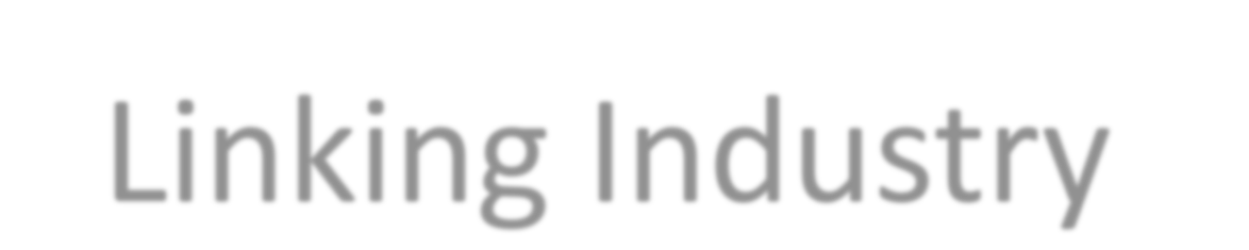

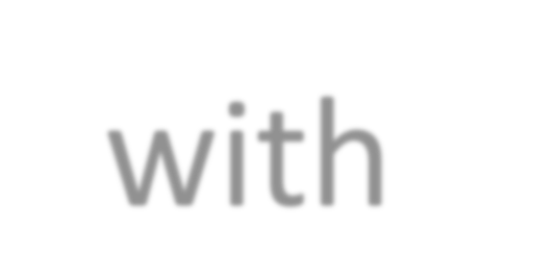
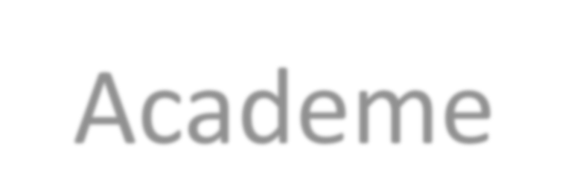

TECHNOLOGICAL INSTITUTE OF THE PHILIPPINES

Slide 2

Objectives
  At the end of the lesson, the student should be able to:
  Apply the types of operators and its hierarchy
  Assess different combination of expression in programing
  Evaluate expression
  Convert mathematical expression to C ++ expression

Slide 3
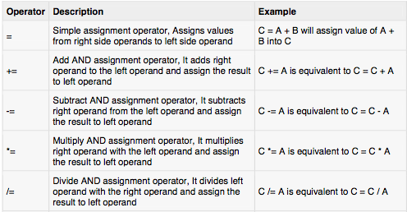
Assignment Operators
Notes:
Possessed: filipino values (honesty and intergrity)
Industry-desired values and global citizen values.

Slide 4
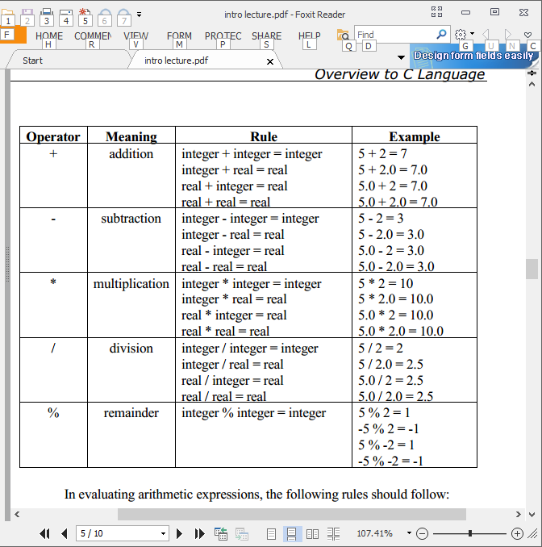
C++ Language Operators
ARITHMETIC OPERATORS – the following table will show the different operators and their uses. The rule shows the type of operands where the operator can be used and the resulting data type given the operands.
modulus

Slide 5
C++ Language Operators
In evaluating arithmetic expressions, the following rules should follow:
1. Parenthesis First- Evaluate expressions that are enclosed in parenthesis. If there are nested parenthesis, evaluate from inside out.
2. Operator Precedence- Evaluation of operators should follow a hierarchy
of priorities. Evaluate expressions with higher priority operators first. unary +, - (positive and negative) highest
*, /, %
binary +, - (addition and subtraction) lowest
3. Associativity Rule-If expression to be evaluated have operators that are in the same precedence level, evaluate the expression from left to right.

Slide 6
C++ Language Operators
Associative :Example
1) 8 – (3 + 9 /2) + 2 * 5
8 – ( 3 + 4) + 10
8 – 7 + 10
1 + 10
11
  2) 12 % 5 * 2 / 2 + 6 – 3
  2 * 2 / 2 + 6 -3
  4 / 2 + 6 - 3
  2 + 6 - 3
  8 - 3
  5
Notes:
Possessed: filipino values (honesty and intergrity)
Industry-desired values and global citizen values.

Slide 7
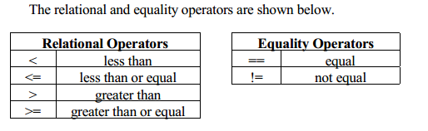
C++ Language Operators
Logical and Relational Expressions - evaluation of logical and relational expressions return 0 for false and 1 (or any nonzero value) for true.
Notes:
Possessed: filipino values (honesty and intergrity)
Industry-desired values and global citizen values.

Slide 8
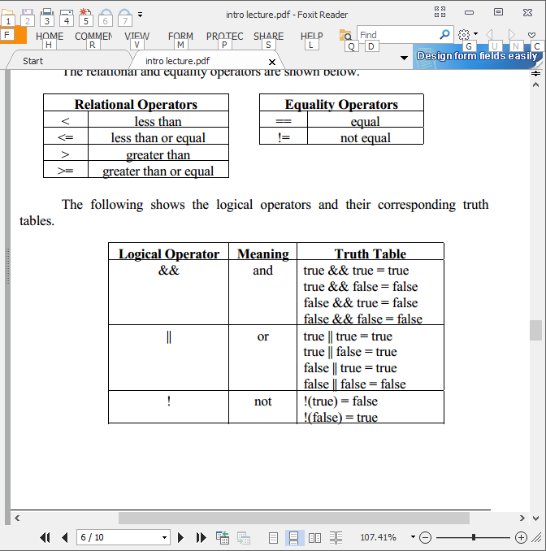
C++ Language Operators
Logical and Relational Expressions - The following shows the logical operators and their corresponding truth tables.
Notes:
Possessed: filipino values (honesty and intergrity)
Industry-desired values and global citizen values.

Slide 9
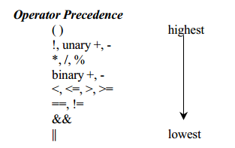
C++ Language Operators
Rules in Operators Precedence
Notes:
Possessed: filipino values (honesty and intergrity)
Industry-desired values and global citizen values.

Slide 10
C++ Language Operators
Evaluation of expressions: Example
1) 7 >= (3 + 9 /2) && 2 * 5 < 10
7 >= ( 3 + 4) && 10 <10
7 >= 7 && F
T && F
F
  2) 12 % 5 != 2 / 2 | | 6 < 3 && 8 >3
  2 ! = 1 | | F && T
  T | | F && T
  T | | F
  T
Notes:
Possessed: filipino values (honesty and intergrity)
Industry-desired values and global citizen values.

Slide 11
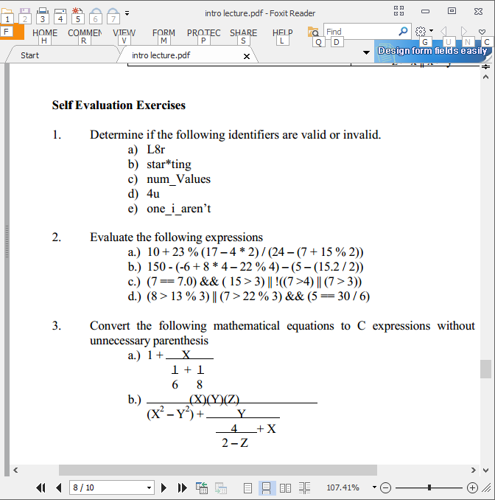
C++ Language Operators
Evaluate the following expressions:
Notes:
Possessed: filipino values (honesty and intergrity)
Industry-desired values and global citizen values.

Slide 12
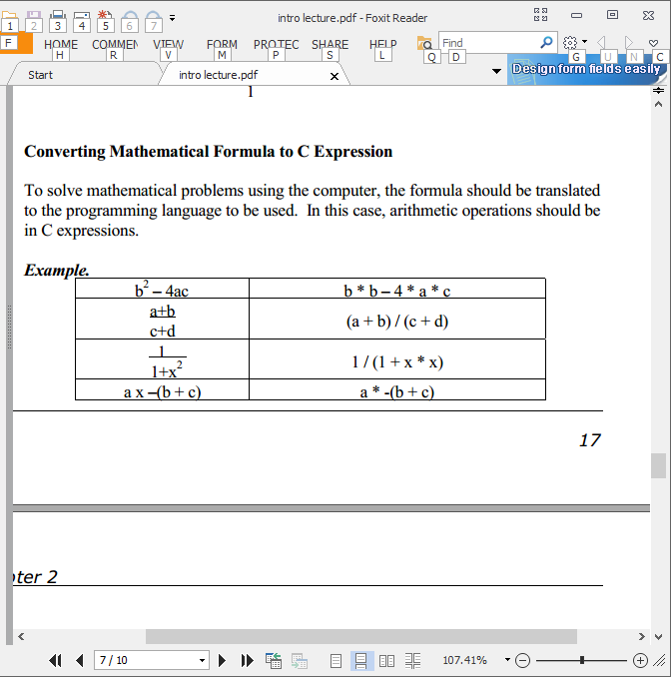
C++ Language Operators
Converting Mathematical Formula to C Expression - To solve mathematical problems using the computer, the formula should be translated
to the programming language to be used. In this case, arithmetic operations should be in C++ expressions.
Notes:
Possessed: filipino values (honesty and intergrity)
Industry-desired values and global citizen values.

Slide 13
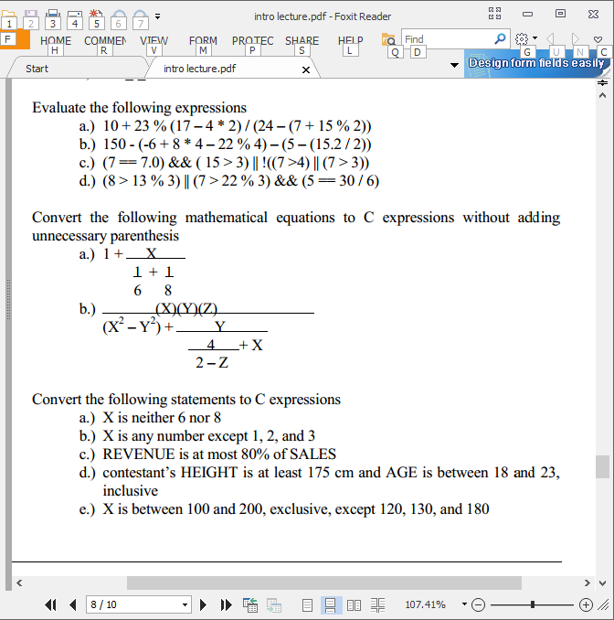
C++ Language Operators
Convert the following mathematical equations to C++ expressions without adding unnecessary parenthesis
Notes:
Possessed: filipino values (honesty and intergrity)
Industry-desired values and global citizen values.

Slide 14
Activity
login to your quizziz.com account
enter the code:
Notes:
Possessed: filipino values (honesty and intergrity)
Industry-desired values and global citizen values.

Slide 15
Prelim Quiz 2 –
Flowcharting and Operators
Notes:
Possessed: filipino values (honesty and intergrity)
Industry-desired values and global citizen values.

Slide 16
Topic this afternoon –
Conditional Expressions
Notes:
Possessed: filipino values (honesty and intergrity)
Industry-desired values and global citizen values.

